Slide 1
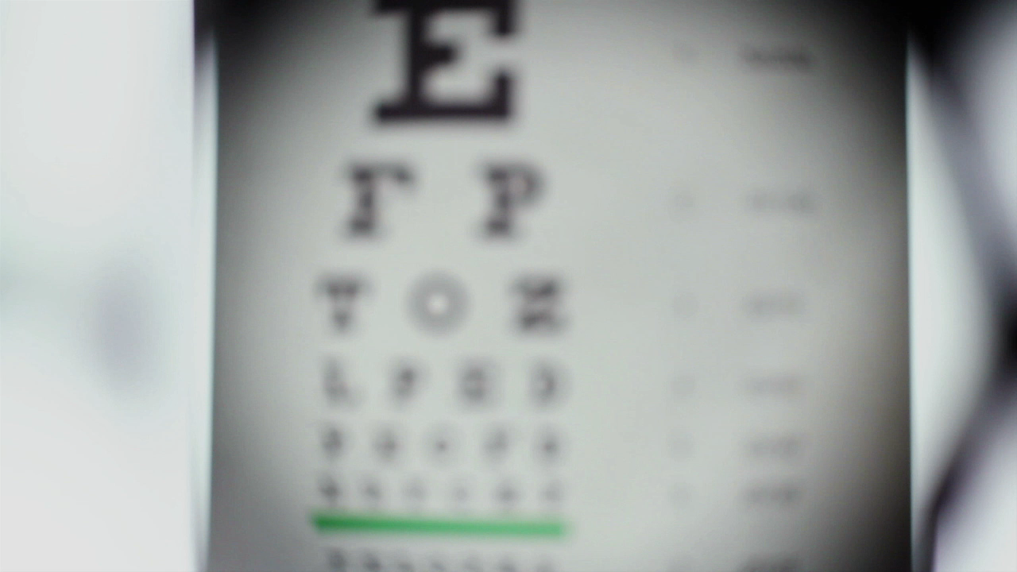
Insert and format graphic elements
Anisa Rachmawati, S.E., M.Acc

Slide 2

Objective 5
5.1 Insert illustrations and text boxes
5.2 Format illustrations and text boxes
5.3 Add text to graphic elements
5.4 Modify graphic elements
Anisa Rachmawati, S.E., M.Acc

Slide 3

5.1 Insert illustrations and text boxes
Insert and modify shapes
Insert pictures
Insert SmartArt graphics
Insert screenshots and screen clippings
Insert text boxes
Anisa Rachmawati, S.E., M.Acc

Slide 4
5.2 Format illustrations and text boxes
format objects
Format SmartArt graphics
Anisa Rachmawati, S.E., M.Acc

Slide 5

5.3 Add text to graphic elements
Insert text in text boxes and shapes
Modify SmartArt graphic content
Anisa Rachmawati, S.E., M.Acc

Slide 6
5.4 Modify graphic elements
Control the placement of objects within text.
Objects on the page can be anchored to a paragraph, be positioned in a
specific location on the page, or float independently. The location, position,
and text wrapping options determine how the object interacts with text
around it. The Arrange group on the Format tool tab for the selected object
contains commands for specifying the relationship of the object to the page
and to other elements on the page.
By default, Word inserts shapes in front of the surrounding text, and other
graphic objects in line with the surrounding text. You can change the
position of the object on the page and the way text wraps around it.
Anisa Rachmawati, S.E., M.Acc

Slide 7

Manage document collaboration

Slide 8

Pokok bahasan
Objective 6.1: Add and manage comments
Objective 6.2: Manage change tracking

